Slide 1
Juneteenth Nova Star Scholarship Competition Show Juneteenth Spoken Word Scholarship Competition Freedom Day Celebration Annual Juneteenth Ceremony
Juneteenth 2024 Sponsorship Opportunities

Slide 2
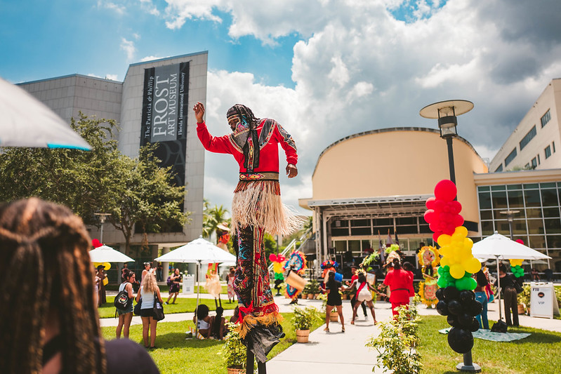
About FIU’s Juneteenth Celebrations
FIU is excited to host the University’s fourth annual Juneteenth Celebration. Under the theme “Celebrate, Educate, Heal”, this weeklong celebration (June 12- 19, 2024) brings together FIU students, faculty, staff, our alumni and the South Florida Community, to bring awareness to the importance of Juneteenth in American history.
The enduring focus of FIU's annual Juneteenth festivities is to celebrate the legacy of freedom, educate our community, and support the needs of our underrepresented minority students in collaboration with our sponsors. All events during this festive period are open to the general public.

Slide 3
Juneteenth Nova Star Scholarship Competition Show
The week of celebration begins on Wednesday, June 12, 2024, with the third annual Juneteenth Nova Star Scholarship Competition Show. A celebration of student talent, the competition is open to all students, and to date has awarded more than $20,000 in scholarships to contestants. The winning contestants as well as the other participating contestants receive $7850 in scholarship prizes.
This inclusive, all genders competition, provides scholarships to students exemplifying leadership qualities, self confidence, and a commitment to their FIU community and beyond. Contestants will compete in categories such as FIU spirit, talent, Q & A session, and a speech on a social justice issue they are passionate about.
Net proceeds from the event are also used to support various needs of underrepresented minority graduate students here at FIU. To date, more than $7500 have been awarded to students in need including housing stipends.

Slide 4
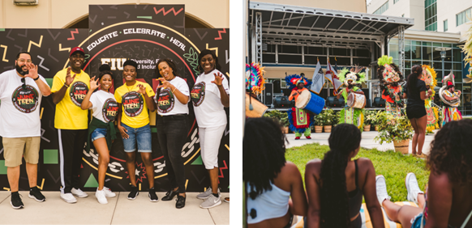
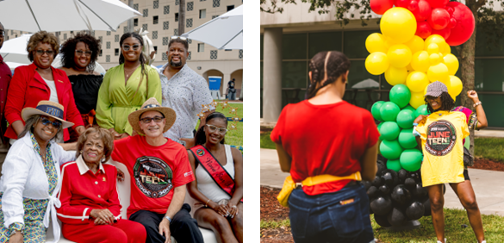
4th Annual Freedom Day Celebration
FIU’s annual Freedom Day Celebration will take place on Saturday, June 15, 2024, on the Earlene and Albert Dotson Pavilion, Modesto Maidique Campus (MMC). This free community event is open to all and features performances, music, art exhibitions, food trucks, and more, in a family friendly environment. Participants can shop from local artisans, indulge in food from specialty food trucks, and engage in an afternoon of entertainment for all ages- all themed around Black and African American culture and history. Sponsorship benefits include a VIP area for sponsors and the opportunity to promote their organization to attendees through flyers, samples or giveaways in our Juneteenth “swag bags” for attendees.

Slide 5
2,200+
15
UNIQUE PAGE VIEWS FOR GO.FIU.EDU/JUNETEENTH
TOTAL EVENTS
ACROSS THE WEEK
7,000+
>1,500
Promotional Reach from Previous Years
USERS REACHED
THROUGH INSTAGRAM
TOTAL ATTENDEES

Slide 6
Signature
Sponsorship Opportunities

Slide 7
Special Sponsorship Opportunities - $3,000
Both signature events include exclusive sponsorship opportunities that are fully branded and customizable:
Nova Star Competition
Freedom Day Celebration
Trophy and crown sponsorship
Contestant and Judge appreciation basket sponsorship (in-kind donations allowed)
Contestant attire sponsorship (in-kind donations allowed)
Kids area sponsorship
VIP area sponsorship
Photobooth sponsorship
Shirt sponsorship
Tote Bag sponsorship

Slide 8
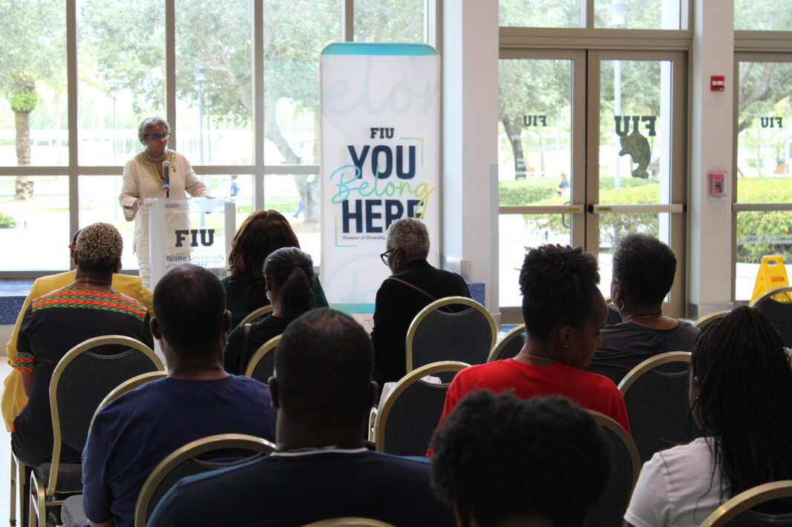
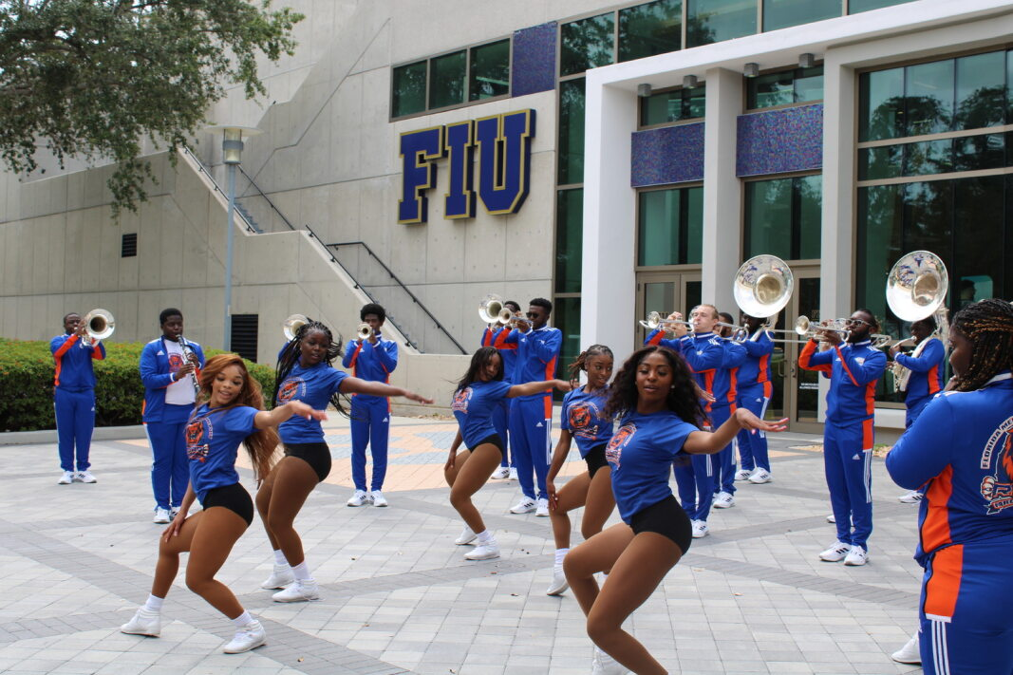
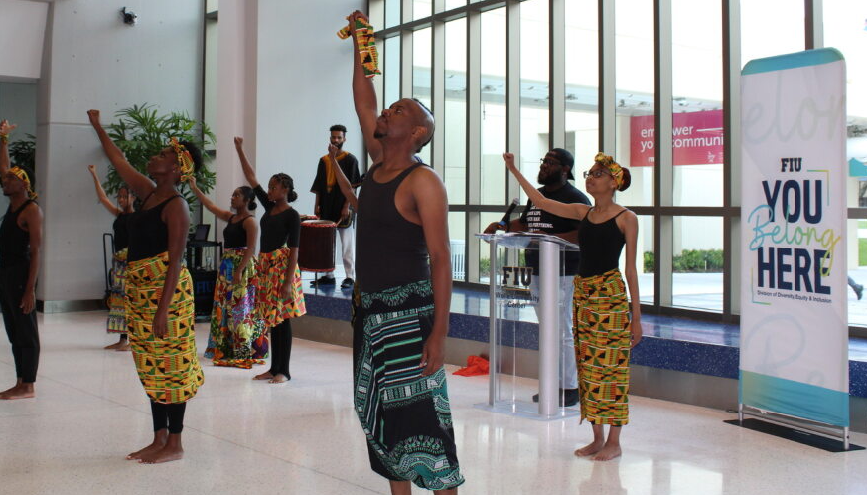
Special Sponsorship: Naming Sponsor
Naming Sponsor: $ 20,000
Annual FIU Juneteenth Ceremony
This special ceremony is held on June 19th each year, the official day of Juneteenth, at FIU’s Biscayne Bay Campus and features marching bands, artisan vendors, special guest speakers, university marching bands and food trucks.
Listed as naming sponsor, with logo included in all event materials, digital/ social media activations and collateral (e.g. The [Your Company Name Here] Annual FIU Juneteenth Ceremony)
Opportunity for company representative to participate in on-stage programming/podium time
Sponsorship designation on all Juneteenth events
Ten food truck meal vouchers at Juneteenth Freedom Day Celebration
Opportunity to include company branded giveaways inside Juneteenth Freedom Day Celebration goodie bags
Plaque to show official Juneteenth sponsorship
Tagged mention with organization’s logo in sponsor appreciation Instagram post

Slide 9
Special Sponsorship: Naming Sponsor
Naming Sponsor: $15,000
Juneteenth Nova Star Scholarship Competition Show
20 tickets to Juneteenth Nova Star Scholarship Competition Show
Listed as naming sponsor, with logo included in all event materials, digital/ social media activations and collateral (e.g. The [Your Company Name Here] Juneteenth Nova Star Scholarship Competition )
Opportunity for company representative to participate as a judge for the competition
Opportunity for company representative to give remarks in showcase on-stage programming
Video featured at Juneteenth Scholarship Show intermission (30-60 seconds)
Sponsorship designation on all Juneteenth events (excluding Sponsor Named events):
Tent/vendor space for brand activation at Juneteenth Scholarship Show
Plaque to show official Juneteenth sponsorship
Tagged mention with organization’s logo in sponsor appreciation Instagram post

Slide 10
Special Sponsorship: Naming Sponsor
Naming Sponsor: $7,000
Juneteenth Spoken Word Scholarship Competition
Students are invited to submit original spoken word pieces that honor the rich history of African American Culture, and that speak to the current year’s themes. Three finalists are selected for winning scholarship prizes, along with consolation prizes for other entries.
Listed as naming sponsor, with logo included in all event materials (excluding other Sponsor Named events): digital/ social media activations and collateral (e.g. The [Your Company Name Here] Juneteenth Spoken Word Scholarship Competition )
Five tickets to Juneteenth Nova Star Scholarship Competition Show
Opportunity for company representative to serve on review committee for entry submissions
Video featured at Juneteenth Scholarship Show intermission (30-60 seconds)
Sponsorship designation on all Juneteenth events (excluding other Sponsor Named events):
Opportunity to include company branded giveaways inside Juneteenth Freedom Day Celebration goodie bags
Plaque to show official Juneteenth sponsorship
Tagged mention with organization’s logo in sponsor appreciation Instagram post

Slide 11
Curated Sponsorship Opportunities

Slide 12
Sponsorship Tiers
Sponsors may choose from different sponsorship opportunities.
$15,000 Steward of Liberation
$10,000 Steward of Resilience
$5,000 Steward of Tenacity
$1,000 Steward of Courage
Title Sponsorship Opportunities
Note that your contribution may be considered tax deductible, where allowed, to the fullest extent under the law as allowed by IRS regulations. Purchase of ads are not considered charitable. Any and all net proceeds from these events, after payment of associated expenses, may be used to support future program expenses including but not limited to student scholarships, through the FIU Foundation, Inc. The amount of your contribution that is deductible is limited to the excess of your contribution over the value of the goods and services provided to you. In accordance with Foundation policy, the Foundation may assess a one-time Advancement Initiative Fee in the amount of 3% of the Gift (“Initiative”) to support the University’s general fundraising and capital campaign expenditures. The Initiative will be collected with the first installment of the Gift (and any subsequent installment, if necessary) in order to fulfill the Initiative as soon as practicable.
See Also Special Sponsorship Opportunities.

Slide 13
Steward of Liberation - $15,000
Ten tickets to Juneteenth Scholarship Show
Video featured at Juneteenth Scholarship Show intermission (30-60 seconds)
Juneteenth Scholarship Show digital event program recognition (mention will include tier level)
Recognition on all event marketing and event day materials (excluding Sponsor Named events): includes emails and social media posts
Sponsorship designation on all Juneteenth events (excluding Sponsor Named events):
Tent/vendor space for brand activation at Juneteenth Scholarship Show
Tent/vendor space for brand activation at Juneteenth Freedom Day Celebration
Access to VIP village at Juneteenth Freedom Day Celebration (10 tickets)
Opportunity to give remarks at Juneteenth Freedom Day Celebration as sponsor
Ten food truck meal vouchers at Juneteenth Freedom Day Celebration
Ten Juneteenth goodie bags with shirts and other sponsored items
Opportunity to include company branded giveaways inside Juneteenth Freedom Day Celebration goodie bags
Plaque to show official Juneteenth sponsorship
Tagged mention with organization’s logo in sponsor appreciation Instagram post

Slide 14
Steward of Resilience - $10,000
Seven tickets to Juneteenth Scholarship Show
Juneteenth Scholarship Show digital event program recognition (mention will include tier level)
Recognition on all event marketing and event day materials (excluding Sponsor Named events) : includes emails and social media posts
Sponsorship designation on all Juneteenth events (excluding Sponsor Named events):
Tent/vendor space for brand activation at Scholarship Show or Freedom Day Celebration
Access to VIP village at Juneteenth Freedom Day Celebration (7 tickets)
Seven food truck meal vouchers at Juneteenth Freedom Day Celebration
Seven Juneteenth goodie bags with shirts and other sponsored items
Opportunity to include company branded giveaways inside Juneteenth Freedom Day Celebration goodie bag
Plaque to show official Juneteenth sponsorship
Tagged mention with organization’s logo in sponsor appreciation Instagram post

Slide 15
Steward of Tenacity - $5,000
Five tickets to Juneteenth Scholarship Show
Juneteenth Scholarship Show digital event program recognition (mention will include tier level)
Sponsorship designation on all Juneteenth events (excluding Sponsor Named events):
Five food truck meal vouchers at Juneteenth Freedom Day Celebration
Five Juneteenth goodie bags with shirts and other sponsored items
Opportunity to include company branded giveaways inside Juneteenth Freedom Day Celebration goodie bags
Logos in Juneteenth event signage (map, program, directional)
Logo in Juneteenth event web pages
Plaque to show official Juneteenth sponsorship
Tagged mention with organization’s logo in sponsor appreciation Instagram post

Slide 16
Steward of Courage - $1,000
Three tickets to Juneteenth Scholarship Show
Juneteenth Scholarship Show digital event program recognition (excluding Sponsor Named events): (mention will include tier level)
Three food truck meal vouchers at Juneteenth Freedom Day Celebration
Three Juneteenth goodie bags with shirts and other sponsored items
Sponsorship designation on all Juneteenth events (excluding Sponsor Named events):
Opportunity to include company branded giveaways inside Juneteenth Freedom Day Celebration goodie bags
Logo in event Juneteenth webpages
Tagged mention with organization’s logo in sponsor appreciation Instagram post

Slide 17
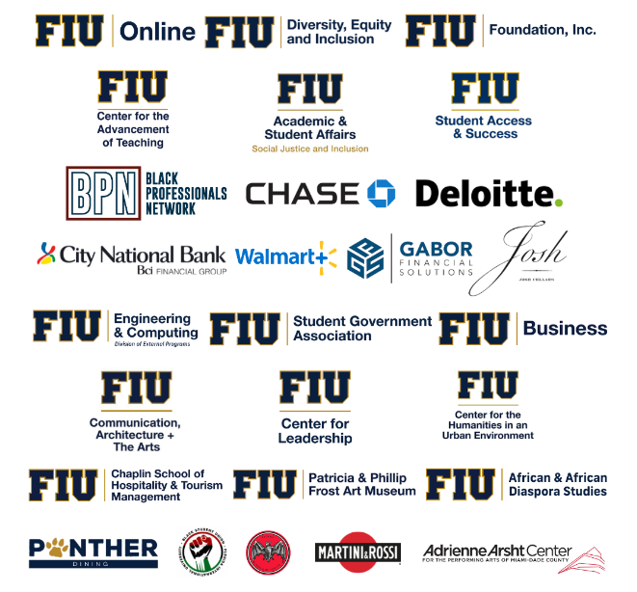
Our Partners
Be a part
of the movement!

Slide 18
For more information, visit:
GO.FIU.EDU/JUNETEENTH

